Slide 1
Airbnb Data Analysis Dashboard: Trends and Insights
An In-depth Analysis of Pricing, Availability, and Trends in Airbnb Listings
J P Abinaya Goud

Slide 2
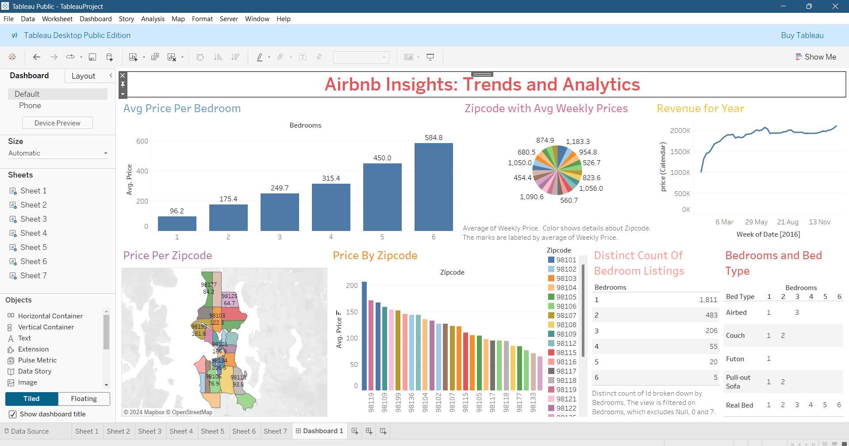
Dashboard of the Analysis:
This analysis explores the trends in Airbnb listings, focusing on pricing, availability, location insights, and popular types of listings.

Slide 3
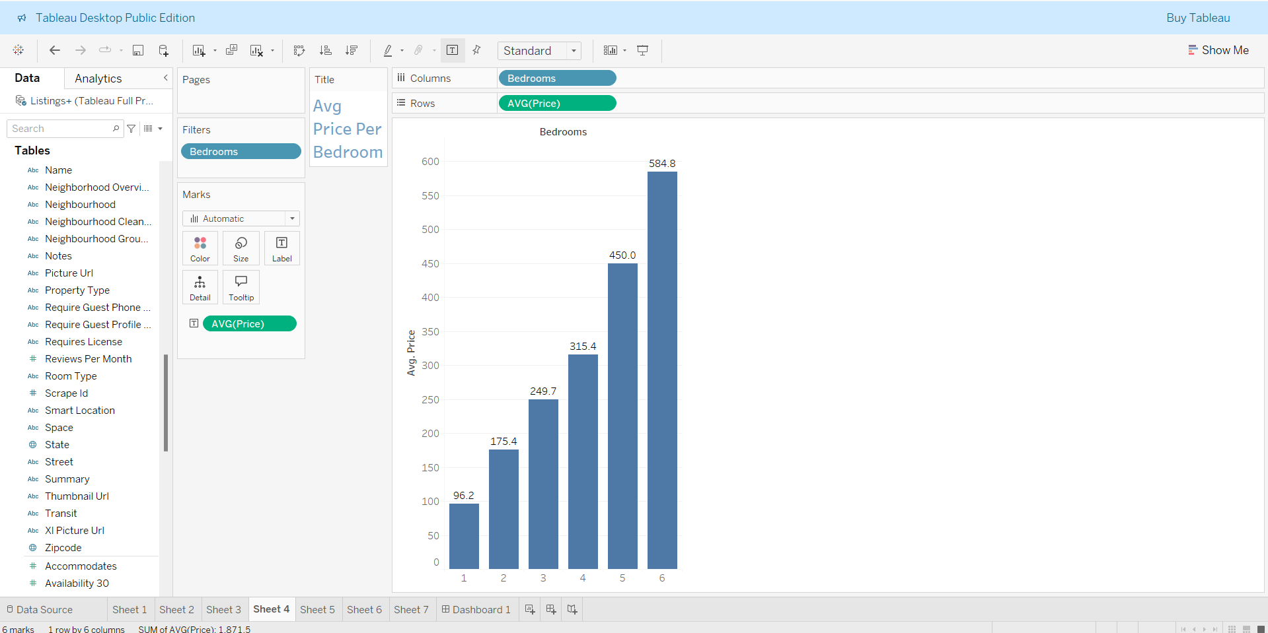
Average Price per Bedroom
Description:
The bar chart shows the average price per bedroom for Airbnb listings.
Analysis:
Prices increase with the number of bedrooms, starting from an average of $96.2 for a single-bedroom listing to $584.9 for six-bedroom properties.
The sharp rise in price after 4 bedrooms suggests that larger properties command premium rates.
Insight:
Larger properties are priced higher, likely catering to larger groups or families, impacting pricing strategies for different property sizes.
Implication for Hosts:
Hosts with larger properties might benefit from targeting groups and families and can consider premium pricing.

Slide 4
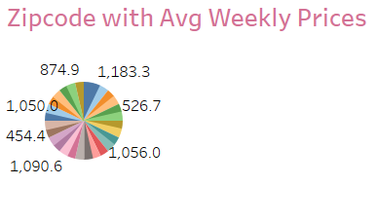
Zip Code with Average Weekly Prices
Description: The pie chart displays average weekly prices for Airbnb listings segmented by zip code.
Analysis:
The highest weekly prices are seen in certain zip codes (e.g., 98109, 98103), indicating higher demand or premium locations.
Zip codes with moderate to lower weekly averages may cater to budget-conscious travelers or have less demand.
Insight: Areas with higher average weekly prices are potentially more desirable or closer to major attractions.
Implication for Hosts: Hosts in high-demand zip codes can optimize pricing, while those in lower-demand areas might focus on improving amenities to attract guests.

Slide 5
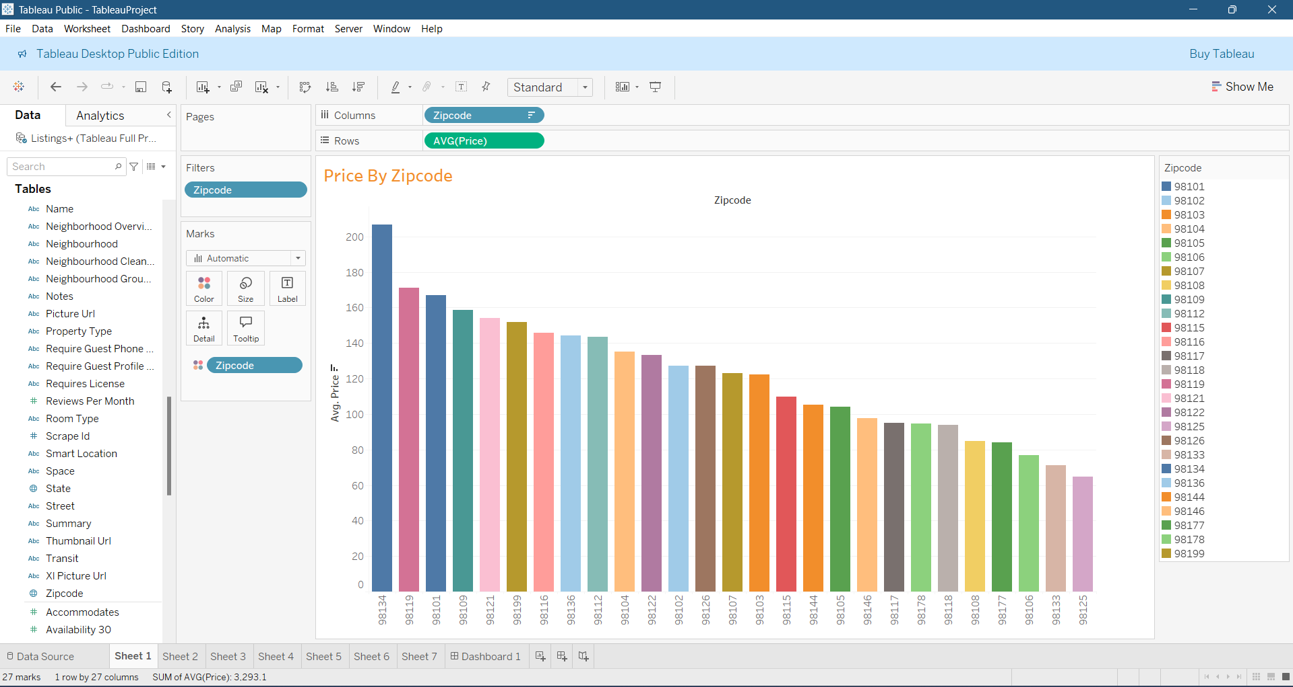
Price per Zip Code
Description: The bar chart ranks zip codes by the average price of Airbnb listings.
Analysis:
Zip codes like 98119, 98109, and 98102 exhibit the highest average prices, indicating their popularity or exclusivity.
Lower-priced zip codes could represent less competitive areas or regions with fewer amenities.
Insight: The price variation across zip codes suggests that location significantly impacts pricing, possibly due to proximity to popular areas.
Implication for Hosts: This information helps in competitive pricing strategy and identifying the need for amenities or improvements in lower-demand areas

Slide 6
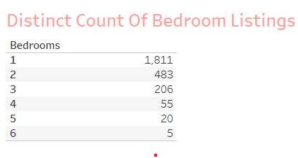
Distinct Count of Bedroom Listings
Description: This table shows the count of Airbnb listings by bedroom count.
Analysis:
Single-bedroom listings are the most common, with 1,811 units, while six-bedroom listings are rare.
This data suggests a strong preference for smaller properties, possibly catering to solo travelers and couples.
Insight: The availability of bedroom sizes aligns with traveler preferences for single and two-bedroom properties, potentially for shorter stays or smaller groups.
Implication for Hosts: Hosts with smaller properties can target solo travelers or couples, while larger properties can market to families and groups.

Slide 7
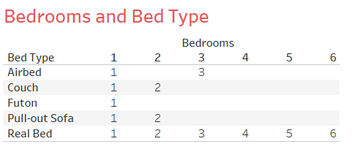
Bedrooms and Bed Type
Description: This table shows the types of beds available for different bedroom counts.
Analysis:
Real beds are widely available across listings, suggesting they are a standard amenity.
Couch and airbed options are less common, usually found in smaller properties or additional sleeping spaces.
Insight: Most listings provide real beds, aligning with guest preferences for comfort. Non-traditional bed types, like airbeds and futons, are supplementary and less common.
Implication for Hosts: Investing in comfortable, real beds could improve guest satisfaction, especially in smaller properties.

Slide 8
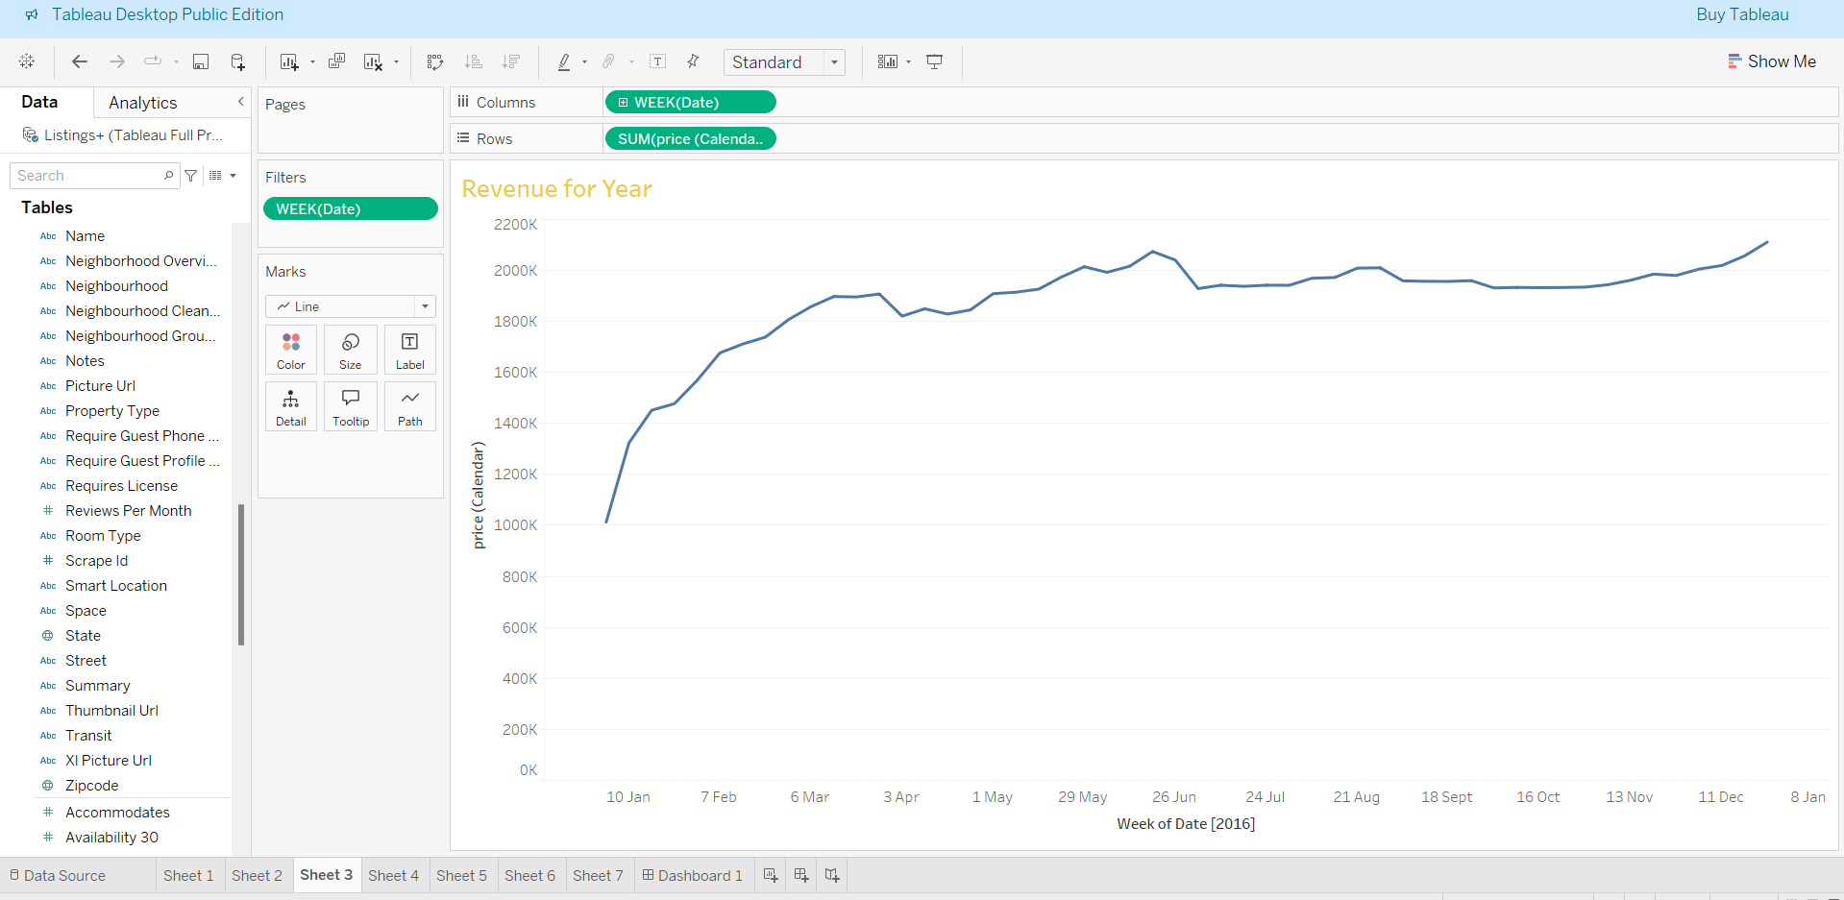
Revenue Over Time
Description: The line chart illustrates Airbnb
revenue trends over time.
Analysis:
The revenue trend shows a steady increase, with slight fluctuations that may represent seasonality or special events.
Periodic drops in revenue could align with off-peak travel times, while peaks indicate high-demand periods.
Insight: There is a positive revenue growth trend, suggesting increasing demand for Airbnb rentals over time.
Implication for Hosts: Understanding seasonality can help hosts optimize pricing during high-demand periods and offer discounts in low-demand periods.

Slide 9
Conclusions and Key Takeaways
Summary of Findings:
Listings with more bedrooms command higher prices.
Certain zip codes show higher average prices, indicating popular or high-demand locations.
Single-bedroom properties are the most common, aligning with traveler demand.
Real beds are the preferred bed type, enhancing guest comfort.
Revenue shows a positive trend, with occasional seasonal fluctuations.
Actionable Insights for Hosts:
Price properties competitively based on size and location.
Consider offering real beds for increased guest satisfaction.
Adjust prices based on seasonal demand for optimized revenue.

Slide 10
Thankyou

